Slide 1


Project Brainchild

Slide 2
| Datara Response
Project Brainchild
01
Introductions
Introducing the Datara team
02
Today’s Problems
Summation of the problem statements
03
Future Intelligence Now
Solution walkthrough
04
Benefits & Delivery
Defining the roadmap.

Slide 3





Project Brainchild
Paul Schweikert
Darren Webber
Corporate Director
General Manager
Paul Schweikert
Darren Webber
Senior Datara stakeholder.
Project management and delivery owner.
Duncan Yule
Stuart Henderson
Duncan Yule
Stuart Henderson
Technical Leader
Solution Designer
Technical quality ownership and principal developer.
Solution architecture and development.

Slide 4
Project Brainchild
Problem
Statements
SPEED
MANUAL
Insufficient velocity of throughput for M&A diligence activities
People Documents. Heavy lifting Reading Understanding Deciding
RISKS
Narrow aperture for vision across M&A work streams leading to gaps and suboptimal decisions.

Slide 5
Solution Walkthrough
Brainchild in Action

Slide 6
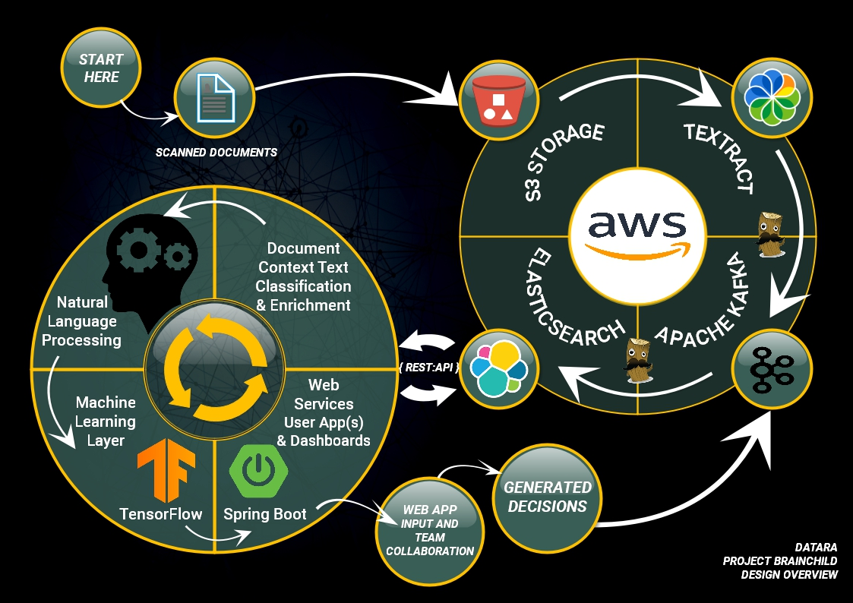



Project Brainchild

Slide 7



Scanned documents are transferred into secure, scalable and cost effective S3 storage.
These are then streamed through AWS Textract where the required data is extracted into consumable form.
Apache Kafka provides a solid persistence layer while offering opportunities for enrichment of the corpus.
The enriched corpus is then sent to Elasticsearch, where the fun begins.

Slide 8



Each Elastic index is optimised for Natural Language Processing. Multiple analyser processes run when each document is ingested.
Execute programmatic sequences made of queries, analysers and comprehensions designed to extract entities, meaning, context, affinity, tone and other dimensions from the Elasticsearch corpus.
The product of these NLP and relational-spatial-term frequency analysis is stored back into the Elasticsearch corpus as fuzzy searchable data.

Slide 9


The data accrued thus far can now be used to power a web application powered by Java Spring Web Services.
Qualifying documents can now be displayed in the browser for bio operators. The UI will feature interactive consoles to:
Direct user attention to the calculated content.
Permit additional input such as comments, annotations and confidence scores from expert users.
Facilitate user collaboration.
Push user content back into the Elasticsearch corpus.

Slide 10



The entire body of analysed content can now be extracted and a decision made. This decision should, to begin with, be reviewed by a human specialist.
If the human specialist agrees or not with the decision, the corpus can now be marshalled into JSON, pushed into a Kafka topic and used for Machine Learning.
This model can learn from what made the decision correct as well as what made the decision wrong. Machine Learning can be used to detect which components were significant in either case. This information can then be folded back into the process.

Slide 11
Better & Faster Decisions
Re-Imagine M&A
Automation
End to end automation
06
01
Project Brainchild
Special Value Points
End to end automation of the process will accelerate decisions and empower resources to add value in other ways.
Data as Interface
Plug in new applications seamlessly via Rest API
Richer Data
Blending of data points and sources
05
02
When enriched data is exposed in Elastic the impact on M&A process and Swiss RE will be significant.
Visualization
Explore and model rich data visually
Instant Answers
Identify useful data quickly
Feedback loop between decisions, whether human or artificial, will ensure constant supply of Machine Learning training data.
04
03

Slide 12

Why choose Datara?
Datara’s core focus is to help companies make future business decisions based on empirical information. We are light and fast, maneuverability is critical in projects like this where there is emphasis on early value. We offer no complicated engagement models, no time-consuming escalation paths; no red tape. The very team you see here today are ready to step into your world and deliver Project Brainchild.

Slide 13

Textract
API Pricing
 | First 1000 Pages | First 1,000,000 Pages (per page) | Effective price per 1000 pages | Over 1,000,000 Pages (per page) | Effective price per 1000 pages
Detect document text API | Free | $00.0015 | $01.50 | $00.0006 | $00.60
Analyze document text API with tables and forms | Free (100 Pages) | $00.065 | $65.00 | $00.05 | $50.00
Note: Parts of this solution are built on AWS storage and services which will incur costs. Datara can better estimate these costs when we have more information about the volume of data and storage needed.

Slide 14
Better & Faster Decisions
Re-Imagine M&A
Automation
End to end automation
06
01
Project Brainchild
Special Value Points
End to end automation of the process will accelerate decisions and empower resources to add value in other ways.
Data as Interface
Plug in new applications seamlessly
Richer Data
Blending of data points and sources
05
02
When enriched data is exposed in Elastic the impact on M&A process and Swiss RE will be significant.
Visualization
Explore and model rich data visually
Instant Answers
Identify useful data quickly
Feedback loop between decisions, whether human or artificial, will ensure constant supply of Machine Learning training data.
04
03

